Slide 1

Evacuation Coordinator Training
2018

Slide 2
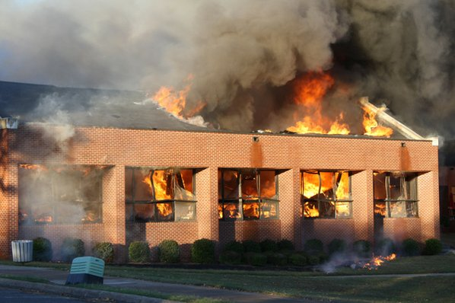
Keep Yourself and Others Safe

Slide 3
Clery Act Requirement
Clery Act requires schools conduct at least one yearly drill to assess and evaluate emergency response and evacuation procedures.

Slide 4
Instructions for Evacuees
Upon hearing the Fire/Evacuation Alarm
  Grab immediate personal belongings
    coat, jacket, sweater, etc…
    vehicle keys
Follow Evacuation coordinator or Campus Safety instructions
Evacuate the building using the nearest SAFE exit

Slide 5
Instructions for Evacuees
Move a safe distance away from all buildings (as determined by evacuation coordinators)
Make a lane for arriving emergency vehicles
Notify an Evacuation Coordinator or Campus Safety Officer of anyone left in the building or needing assistance
Be prepared to be outside for a minimum of one hour

Slide 6
Evacuation Coordinator Duties
Pre-Evacuation Preparation
  Know assigned evacuation zones and routes to those zones
  Be familiar with evacuation guidelines for persons with disabilities
  Know locations of 1st aid, AED, areas of refuge/ emergency evacuation chairs
    Note: Areas of refuge are the same as evacuation chair locations
    All of the above are listed on the campus maps

Slide 7
Evacuation Coordinator Duties
Pre-Evacuation Preparation
  Inventory emergency pack
  Conduct a functions check of the radio
    Ensure dial is set to correct channel
      Fort Steilacoom – Channel 2
      Puyallup – Channel 3
    Ensure the radio powers on
  Report any deficiencies to Campus Safety

Slide 8
Evacuation Coordinator Duties
During Evacuation
  Grab immediate belongings (keys, coats) and emergency back-pack
  Activate radio: Turn on and ensure you are on the correct channel
  Clear your assigned area of all persons
    Offices, classrooms, bathrooms, storage and common areas
    Inform people they are required to leave

Slide 9
Evacuation Coordinator Duties
During Evacuation
  Immediately report:
    Non-compliant persons to Campus Safety
    Those persons who are not able to evacuate,
    If possible, move them to refuge area
    Campus Safety will dispatch someone to respond if available
  Lead evacuees to designated evacuation zones

Slide 10
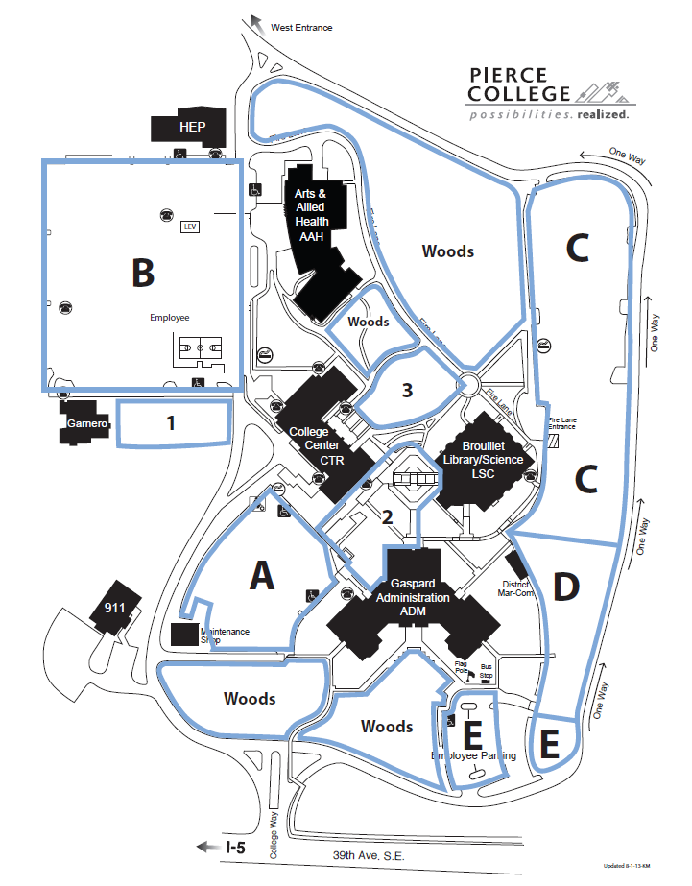
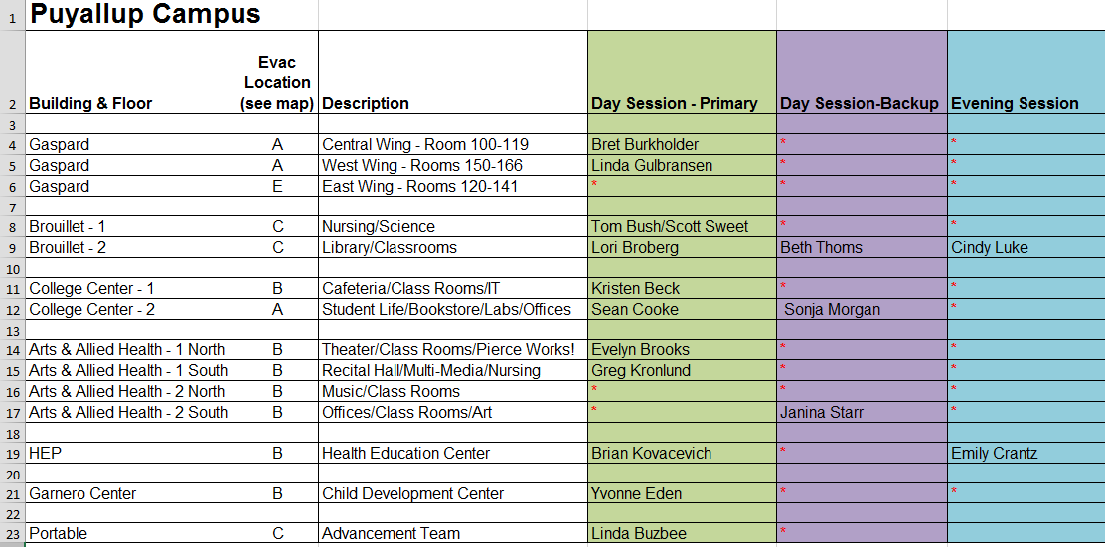
Designated Areas:
- Letters and numbers on the spreadsheet correspond to areas on the map with a blue perimeter
- Evacuation coordinators will lead evacuees to the areas assigned to them on the spreadsheet

Slide 11
Evacuation Coordinator Duties
During Evacuation
  Maintain control and accountability of assigned groups
  Move all personnel a safe distance away from buildings
    As determined by Evacuation Coordinators
    Keep main roadways clear for emergency vehicles
    Immediately notify Campus Safety of unauthorized attempts to enter buildings or other safety concerns

Slide 12
Evacuation Coordinator Duties
During Evacuation
  Maintain radio awareness and listen for updates
  Report status updates to Campus Safety
  Be prepared to disseminate information as required
  In case of a real incident transmit the following: “Emergency”, Then transmit your message
  Personal Safety
    Do not argue with non-compliant persons
    Contact Campus Safety for assistance
    Do not put yourself in harms way

Slide 13
Evacuation Coordinator Duties
After Evacuation
  Disseminate re-call signal: “All Clear, All Clear, All Clear” only after Campus Safety has advised to do so
  Facilitate safe re-entry into buildings
  Take note of evacuation deficiencies and successes
  Provide feedback to evacuation related questions in the days following the evacuation

Slide 14
District Campus Safety
Jeff Schneider, Director
(253)-964-6221
Sgt. Robert Rockey
Fort Steilacoom Campus Safety
(253) 964-6751
Sgt. Maureen Rickertsen
Puyallup Campus Safety
(253) 840-8481

